Slide 1

6th Grade Accelerated Math Unit 8, Lesson 3 Finding the Missing Dimension of a Rectangular Prism Volume 2, pg. 16

Slide 2


Benchmark
MA.6.GR.2.3
Solve mathematical and real-world problems involving the volume of right rectangular prisms with positive rational number edge lengths using a visual model and a formula.
volume 2, pg. 16

Slide 3
Integrated Mathematical Thinking and Reasoning Standards
MA.K12.MTR.1.1 Actively participate in effortful learning both individually and collectively.
MA.K12.MTR.2.1 Demonstrate understanding by representing problems in multiple ways.
MA.K12.MTR.3.1 Complete tasks with mathematical fluency.
MA.K12.MTR.4.1 Engage in discussions that reflect on the mathematical thinking of self and others.
MA.K12.MTR.5.1 Use patterns and structure to help understand and connect mathematical concepts.
MA.K12.MTR.6.1 Assess the reasonableness of solutions.
volume 2, pg. 16

Slide 4

Learning Target
I can find the value of a missing dimension of a rectangular prism.
volume 2, pg. 16

Slide 5

Warm-Up
volume 2, pg. 16

Slide 6
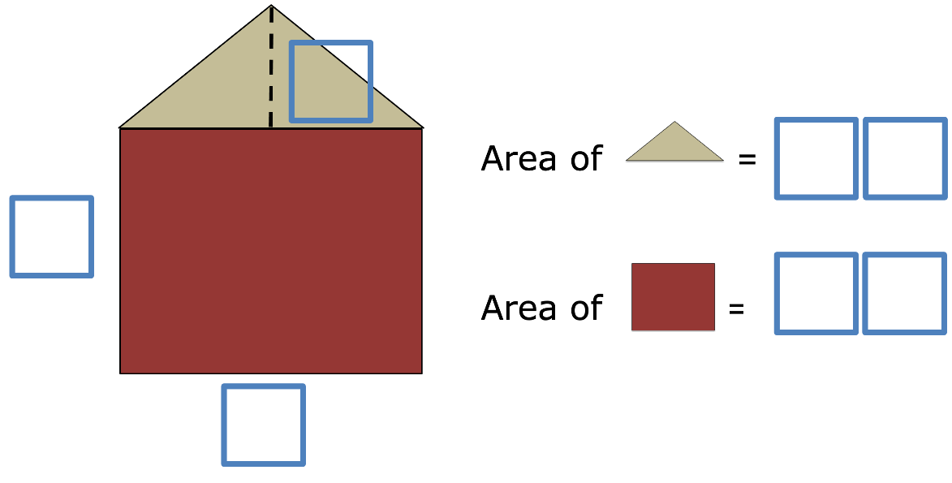
8.3.1 Warm-Up: Area of a Wall
Using the digits $0−9$, at most one time each, fill in the boxes to make a true statement.
volume 2, pg. 16

Slide 7

Collaboration
volume 2, pg. 17

Slide 8

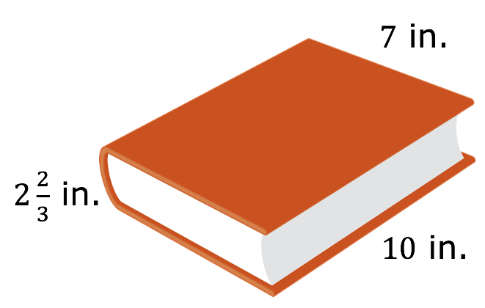

8.3.2 Collaboration: Missing Measurement
Jolene works for a textbook company filling orders. She has discovered each textbook has a width of $7$inches (in.), a height of $2\frac{2}{3}$in., and a length of $10$in.
The textbook company has decided to make the textbooks smaller by reducing the length. The new volume of the textbook will be $168 {in}^{3}$.
volume 2, pg. 17

Slide 9
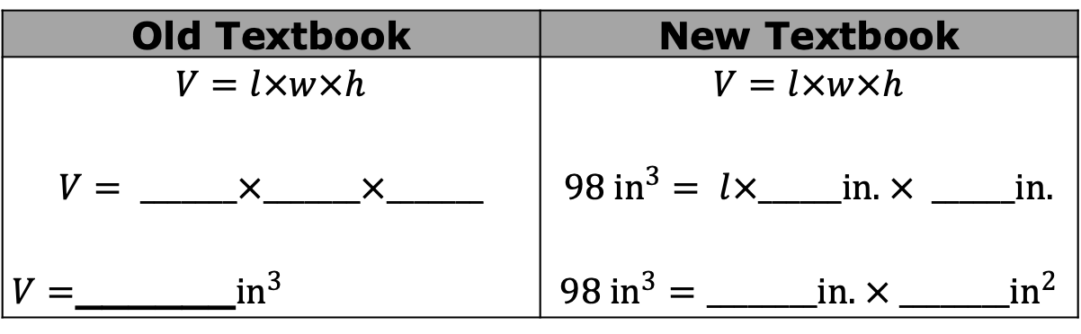
Complete the table.
Work with your partner to determine the new length of the textbook. Explain your process.
Old Textbook | New Textbook
$$V=l×w×h$$ $$V= _______×_______×_______$$ $V=$______${in}^{3}$ | $$V=l×w×h$$ $$98 {in}^{3}= l×______in. × ______in.$$ $$98 {in}^{3}=________in. × ________{in}^{2}$$
volume 2, pg. 17

Slide 10

Guided Instruction
volume 2, pg. 17

Slide 11

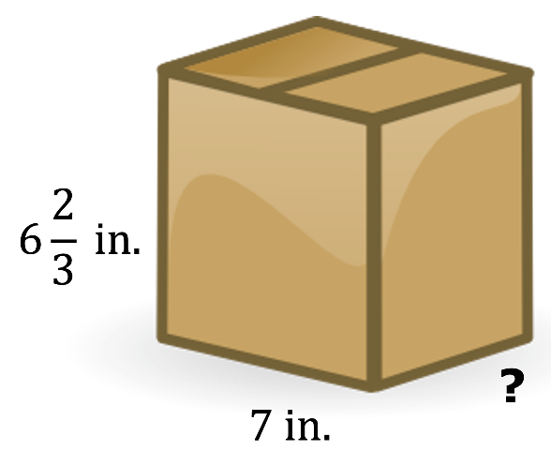
8.3.3 Guided Instruction: Finding a Missing Dimension
Each flat surface of a prism is called a face.
When only two dimensions of a three-dimensional prism are given, the product of the two given dimensions represents the area of that face of the prism.
What is the area of the front face of this prism? Include units.
volume 2, pg. 17

Slide 12
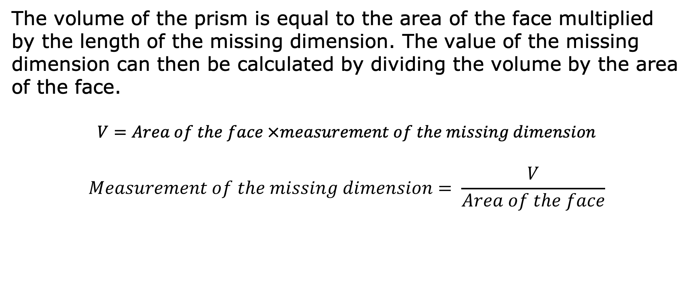
The volume of the prism is equal to the area of the face multiplied by the length of the missing dimension. The value of the missing dimension can then be calculated by dividing the volume by the area of the face.
$$V=Area of the face ×measurement of the missing dimension$$
$$Measurement of the missing dimension= \frac{V}{Area of the face}$$
volume 2, pg. 18

Slide 13
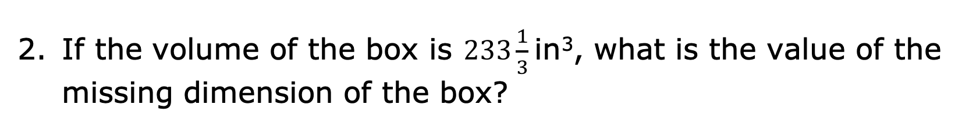
If the volume of the box is $233\frac{1}{3}$in³, what is the value of the missing dimension of the box?
volume 2, pg. 18

Slide 14
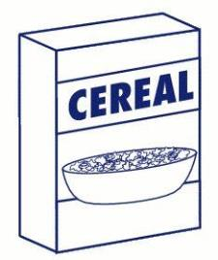


Rafael was trying to find the missing dimension of the cereal box shown.
He made a mistake while solving for the width of the box, but he cannot find it. Inspect his work below.
$30$ cm
$20.3$cm
Volume = $1,218$ cm²
volume 2, pg. 18

Slide 15
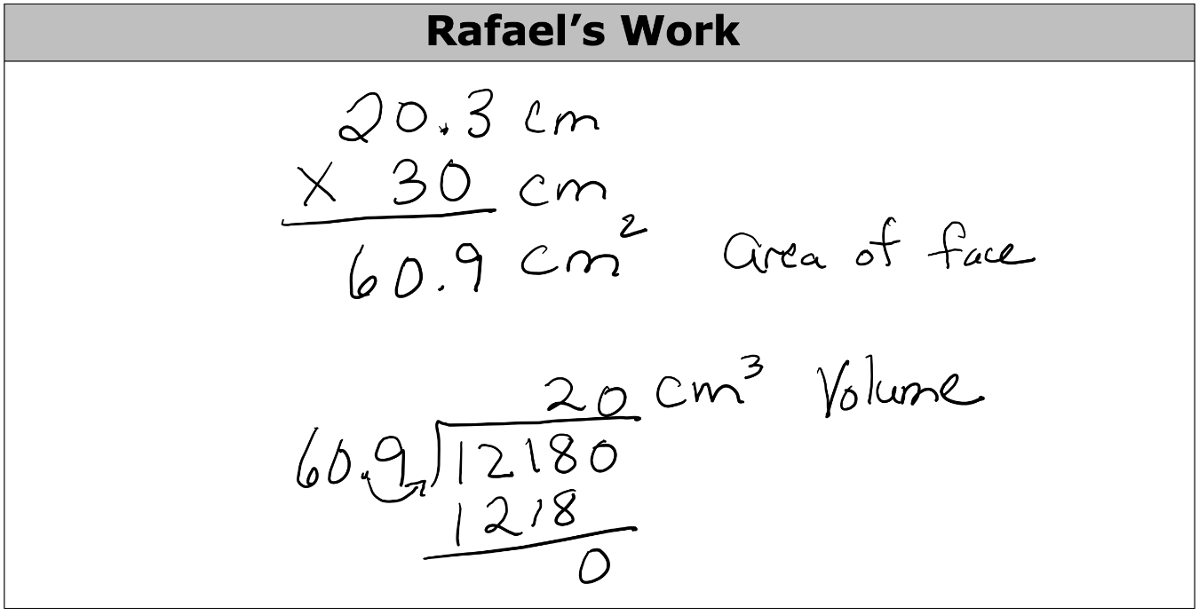
Write a note to Rafael on how to correct his error(s).
volume 2, pg. 18

Slide 16

Guided Practice
volume 2, pg. 19

Slide 17

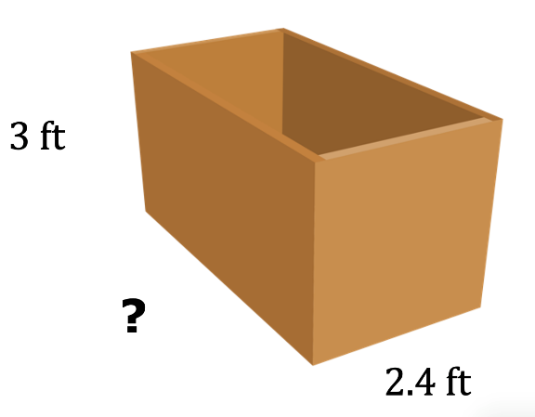

8.3.4 Guided Practice: Find the Missing Dimension
Sally broke her ruler before she finished measuring her toy chest. She knows the toy chest has a volume of $25.2{ ft}^{3}$.
What is the length of the toy chest?
volume 2, pg. 19

Slide 18
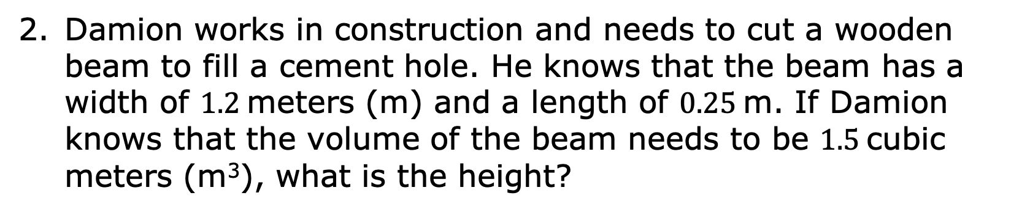
Damion works in construction and needs to cut a wooden beam to fill a cement hole. He knows that the beam has a width of $1.2$meters (m) and a length of $0.25$m. If Damion knows that the volume of the beam needs to be $1.5$cubic meters (m³), what is the height?
volume 2, pg. 19

Slide 19

Your Turn
volume 2, pg. 19

Slide 20
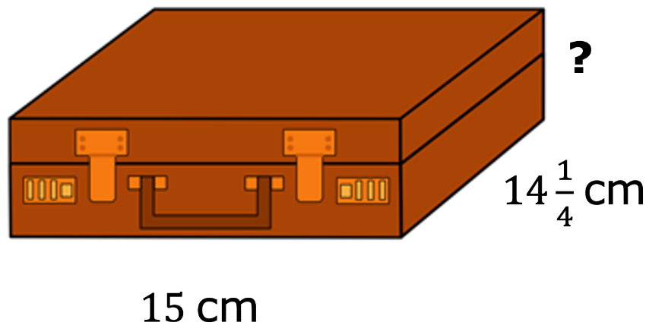

8.3.5 Your Turn!
Mr. Rodrigo knows that his briefcase has a volume of $1,068\frac{3}{4}$cubic centimeters (cm³). He labeled the dimensions of the briefcase that he knew.
What is the height of the briefcase?
volume 2, pg. 19

Slide 21
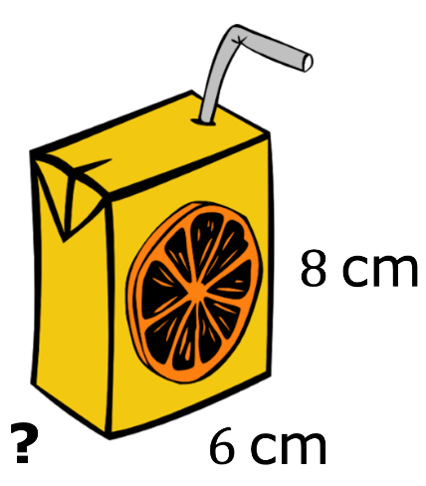

Victor works in a factory that makes juice boxes. He knows that the juice boxes have a height of $8$centimeters (cm), a length of $6$cm, and a volume of $192$ cubic centimeters (cm³).
What is the width of the juice box?
volume 2, pg. 19

Slide 22

Wrap-Up
volume 2, pg. 20

Slide 23
8.3.6 Wrap-Up: Reflection
Rate your strength on the following areas using the scale.
1 – still learning
2 – making progress
3 – got it
Write an explanation of why you rated yourself the way you did.
Skill | Rating
Find the volume of a rectangular prism.
Find a missing dimension of a rectangular prism.
volume 2, pg. 20

